Slide 1
Bringing innovative ideas to Lockscreen June 9, 2014
Idea and compilation: Youness Ghanim Participant: Ludvig Nilson
Lockscreen team, Lund site, Sweden
© Sony Mobile Communications

Slide 2
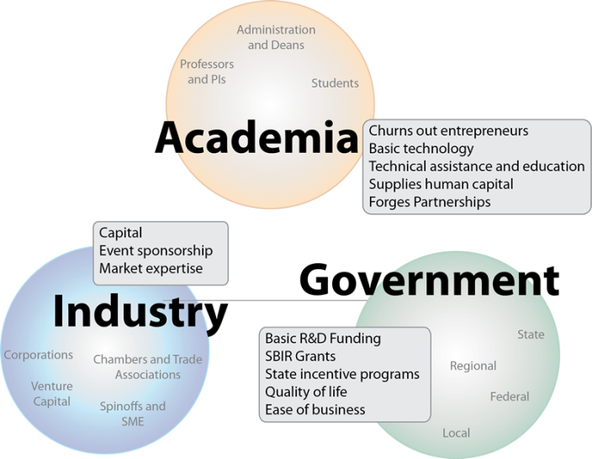
Background:
This initiative was inspired by the triple helix model in innovation
Using the connections between university-industry-government in knowledge based society to drive progress and innovation.
Notes:
The concept of the Triple Helix of university-industry-government relationships initiated in the 1990s by Etzkowitz (1993) and Leydesdorff (1995), encompassing elements of precursor works by Lowe (1982) and Sábato and Mackenzi (1982), interprets the shift from a dominating industry-government dyad in the Industrial Society to a growing triadic relationship between university-industry-government in the Knowledge Society.
The Triple Helix thesis is that the potential for innovation and economic development in a Knowledge Society lies in a more prominent role for the university and in the hybridisation of elements from university, industry and government to generate new institutional and social formats for the production, transfer and application of knowledge. This vision encompasses not only the creative destruction that appears as a natural innovation dynamics (Schumpeter, 1942), but also the creative renewal that arises within each of the three institutional spheres of university, industry and government, as well as at their intersections.
Through subsequent development, a significant body of Triple Helix theoretical and empirical research has grown over the last two decades that provides a general framework for exploring complex innovation dynamics and for informing national, regional and international innovation and development policy-making. This substantive body of Triple Helix literature can be broadly seen from two main complementary perspectives

Slide 3
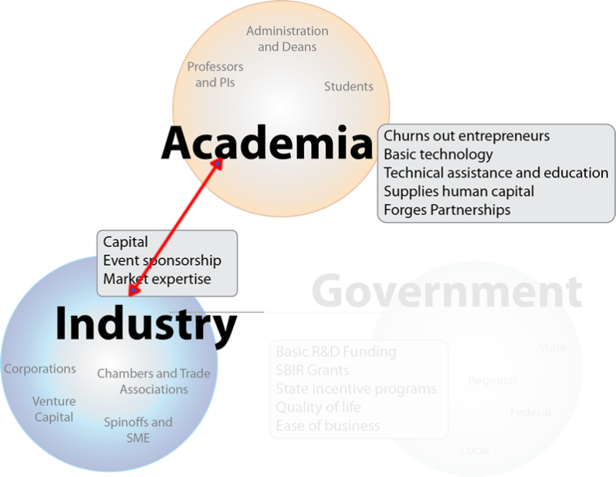
Intention:
In our case the triple helix model will focus more on two helixes and that is industry-academia since there is no direct visible intervention of the government, but by means of existing policies and public institutions.

Slide 4

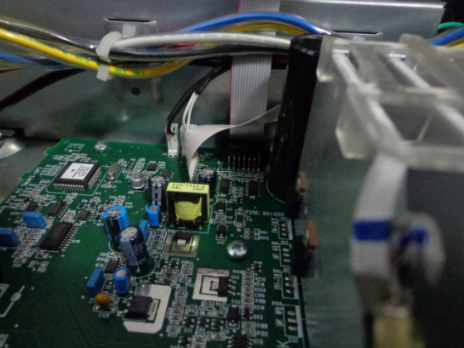

Intention:
The motivations behind this initiative are:
Out of the corporate mindset and on different levels!
“The secret of change is to focus all of your energy, not on fighting the old, but on building the new.” – Socrate.
By “old” I mean here established business processes and daily routine only.
.
Too busy fixing old stuff
Too focused on couple components
We may run out of ideas!
Notes:
Need for new ideas and creativity to come into play and improve our Lockscreen but out of the corporate mindset and on different levels, as many levels as possible, from usability, look and feel to functionality, etc (there is no limit here).
One way to realize this, is by contacting art and visual communication departments at universities within Sweden or if possible even within Copenhagen, Scandinavia or on the EU level.
Engage academia in projects from Sony, so they can drive the task of coming up with new ideas.
Need to hunt for new fresh ideas from academia (art students or top graphics design and art schools driven by enthusiasm) to make the best contribution possible in society and for us to revitalize Lockscreen.
Schools or art colleges can be assigned projects to work with and are possible to be bound to an NDA.

Slide 5


Intention:
Contacting top art and visual communication departments at universities within Sweden or if possible even within Copenhagen, Scandinavia or on the EU level.
Notes:
Need for new ideas and creativity to come into play and improve our Lockscreen but out of the corporate mindset and on different levels, as many levels as possible, from usability, look and feel to functionality, etc (there is no limit here).
One way to realize this, is by contacting art and visual communication departments at universities within Sweden or if possible even within Copenhagen, Scandinavia or on the EU level.

Slide 6

Intention:
Students from top graphics design and art schools driven by enthusiasm.
When we say Lockscreen, we mean both secured and none secured Lockscreens.
In this initiative we want to take the most out of academia, hence no restrictions will be imposed.
NDA
Enthusiasm & no restrictions
Notes:
Need to hunt for new fresh ideas from academia (art students or top graphics design and art schools driven by enthusiasm) to make the best contribution possible in society and for us to revitalize Lockscreen. Fresh young students may have fresh new ideas and are very likely driven by enthusiasm compared to corporate employees working for a salary (dynamism, risk taking & adventure thinking vs. routine, locked view & defensive thinking).
Schools or art colleges can be assigned projects to work with and are possible to be bound to an NDA.
Engage academia in projects from Sony, so they can drive the task of coming up with new ideas. To get out of the box ideas we need to give designers the freedom to exploit Lockscreen freely from different angles and then compile potential creative ideas.

Slide 7

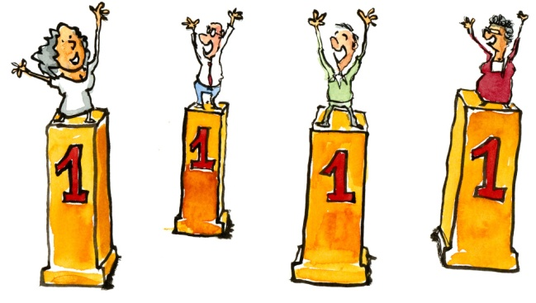
Intention:
Cooperating with art colleges on projects must provide enough ground for creativity, innovation, exchange of ideas and also motivation for academia to provide something at the end. Why?
A win win situation for all of us.
Satisfactory outcome, every one wins
Shared interests
Notes:
It is always tempting for Universities to have contacts within the industry, which is “us” in this case.
It works for them as a selling factor when attracting students. So the doors for cooperating are open. They want to create a positive cooperation to maintain reputation and future cooperation.
Students want to prove themselves, get good grades, get recognition, make contacts with the industry, and put something they can be proud of on their CVs.

Slide 8

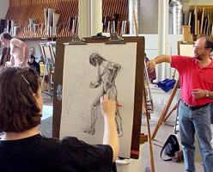
Method of work:
We the industry are going to academia:

Slide 9
Method of work:
Two academic entities have been selected so far (more will be added upon approval from management for this initiative).
Youness to contact them as an initial step and of course more will join, Anna, Jörn, Lars, Velmir.
Hyper Island: Hyper Island designs learning experiences that challenges companies and individuals to grow and stay competitive in an increasingly digitized world. Our range of immersive programs and courses seeks to equip you with the necessary knowledge and skills to lead the change and begin a journey of lifelong learning. http://www.hyperisland.com/about Contact name Clara: + 46 707 7762 71

Slide 10
Method of work:
Malmö University / School of Arts and Communication: The department is also called "K3" after the Swedish name, Konst, kultur och kommunikation. At K3 we combine traditional scholarship and academic knowledge with artistic methods and practical skills. In our teaching and research, art, technology, design and communication converge in new and innovative ways. We focus on user-driven education and research and collaborative projects that challenge traditional boundaries. At K3 there is an emphasis on openness and creativity, always in combination with critical analysis and social consciousness. http://malmouniversity.dk/k3/english Contact name: Sara Bjärstorp, head of School of Arts and Communication. Phone: +46 40-66 57754
Royal Danish Academy of Fine Arts Phone: +45 33 74 46 00

Slide 11
Method of work:
Find what has been missing in Lockscreen.
What no other locksreen has ever offered.
What has been produced before.
Building a team: Anna, Jörn, Youness, Ludvik, Lars Novak, Velmir.
Create a documentation backed up with a presentation such as face to face meeting, over the phone conversations, or PPT slide showing:
What is lockscreen?
What we want from them, for example with:
State of the art future proof Lockscreen?
New look & feel
Core mechanisms for unlocking. Why always swipe? Are there more appealing methods to unlock?
What is missing when we think of locking and unlocking?
Introduce the fun/playful factor in usability (fun yet with quality).
We want to create something engaging if not addictive for consumers, (waw affect).
Creating a strong positive experience when using Lockscreen (ease of use, intuitive, new layout, useful info on screen, vital shortcuts etc).
Notes:
The need to think of something missing that no Lockscreen has offered before, and for that the need to investigate what has been produced before.
We will create a project documentation backed up with a presentation such as face to face meeting, over the phone conversations, video conferencing or PPT slide shows stating what we
want from these entities, i.e. that we want them to come up for example with:
Concepts pertaining to how a state of the art future Lockscreen should look like.
What concepts can come into the scene to replace the existing Lockscreen look, feel and the core mechanisms for unlocking. How this can be replaced with something that doesn’t exist yet in the market?
Why always swipe? Is there a more appealing method to unlock?
What is missing when we think of locking and unlocking?
Introduce the fun/playful element in usability, fun yet with quality.
How Lockscreen can be more engaging if not addictive for consumers. That they feel proud owning our phones with such Lockscreen (waw affect).
How we can create a strong positive experience when using Lockscreen (ease of use, intuitive, new layout, useful info on screen, vital shortcuts etc).

Slide 12
Method of work:
As mentioned above, projects can be assigned to art institutions. In the case of Malmö University for example it would be something like 2 – 3 months project, and may start as soon as the semester begins. It will be beneficial to have more than one group working on this so that we get more ideas (parallel teams in action, several out come at the end).
The outcome from these groups would be simulation videos, 3D animation or story boarding depicting how the groups’ ideas would be in real life if they were to be implemented.
The groups will go through our request and build their own ideas and propose them to us in terms of media content, might be interactive, as mentioned video, animation or series of static images or documentation with visuals explaining in details their intention.

Slide 13
Method of work:
We could have chosen “an event” proposal with universities but in such case it might not be the best option, since this is a voluntary participation from interested departments or students, while projects can be mandated and followed.
With events, we are not so much in control and we don’t know what could come out of them, especially if they are not motivated the right way. In the case of projects, we can follow the progress with contact people, teachers, or coordinators and there will be an agreed on time frame after which we can get something delivered to us while the NDA is in place.
Hackaton event, is another option but upon reflecting on it, we realized it may suffer the same issues as sponsored events, no control, voluntary, no guaranteed result, and perhaps no NDA to be enforced.

Slide 14
Method of work:
Hence in conclusion we believe the preferred method of work would be offering academia and art colleges projects is the ideal track and this has enough motivation to get something in return.

Slide 15
Plan of execution:
Put together a project (documentation) illustrating what we want, may be a one page document so we don’t impose any restrictions and then let the other parties exploit what we want in their own way.
Offer complementary demonstration on the different Lockscreens and what they do or a recorded video of that (developer world may help).
Once Sony and the other parties feel are on the same page in terms of expectations and delivery time frame, then we do the hand shake, sign the NDA and let them execute the creative work!
Identify points of contacts within these originations to maintain periodical updates and loops of feedback, offset the course of progress if deemed necessary.
A result will be delivered to Sony, an evaluation will be made on the best ideas and if applicable convert these ideas into tangible products.

Slide 16
Plan of execution:
An award perhaps or some sort of recognition can be given to the best 3 top ideas.
There is also a side social marketing point, and that is how we can market this in the media as Sony being active within the society and helping in evolving academia on national, regional or supra-national levels.
Since it is university-industry helix, we may as well find in the future how government can be added into this equation to make it a complete triple helix.
These are a questions to be addressed from long term innovation perspective.

Slide 17
Expectations in a brief!?
Create channels of cooperation with art and digital communication schools, and provide projects that can be developed further for the benefit of Lockscreen innovation and creative ideas.
In this cooperation we aim first to illustrate the status quo and challenge it with new ideas coming from academia.
Sony to provide projects, and art colleges to come up with new concepts that could possibly revitalize Lockscreen.
Loops of feed back and follow up to be maintained during these projects so the evolution of ideas is assessed and if needed corrected to address what we want.
At the end whatever we could collect from art colleages would be a property of Sony and we have the right to claim them, modify them or develop them. If needed UXC may get involved as well.
Sony to evaluate the top 3 ideas and provide some sort recognition or reward.

